Slide 1

Software construction Lab LAB # 07
Objective:
Abstraction functions and rep invariants
Prepared and Presented By: Engr. HAMZA

Slide 2

OUTCOMES OF Abstraction functions and rep invariants
Objectives/Outcomes
After this lab student will be able to understand:
Abstraction Functions:
Conceptual Understanding
Mapping Real-World Entities
Clarity in Design
Rep Invariants:
Ensuring Data Consistency
Preventing Inconsistent States
Debugging and Testing
Learning Outcomes:
Design Thinking
Implementation Skills
Maintenance of Code Quality
Critical Thinking
Application in Software Engineering

Slide 3
What is Abstraction Functions
Definition:
An abstraction function is a mapping from a concrete representation of an object to its abstract value. It provides a way to interpret the concrete data structure in terms of the abstract data type it represents.
Abstraction Function: It's like a translator that takes the complicated stuff happening inside a machine and shows us something simple and understandable. Like how a digital watch shows us the time, even though there's a lot going on inside it.

Slide 4
Let's understand this!
a string (a sequence of characters) as an example:
Concrete Representation: Imagine you have a specific string, like "Hello, World!" This is the concrete representation of a string. It's the actual sequence of letters and punctuation.
Abstract Value: Now, let's think about what a string is in a more abstract way. Instead of focusing on the specific letters and punctuation in "Hello, World!", we think of a string as just a series of characters, any characters, placed together in a certain order.
Abstraction Function: The abstraction function is like a translator that takes you from the concrete representation ("Hello, World!") to the abstract value (a sequence of characters). It helps you interpret the actual characters as part of the broader concept of a string.

Slide 5



Real-World Application:
Imagine a digital watch. The internal workings of the watch, including its circuits, battery, and software, are complex. However, when you look at the watch, you only see the time displayed. The abstraction function here is the mechanism that translates the intricate internal state of the watch to the simple time display you see.

Slide 6
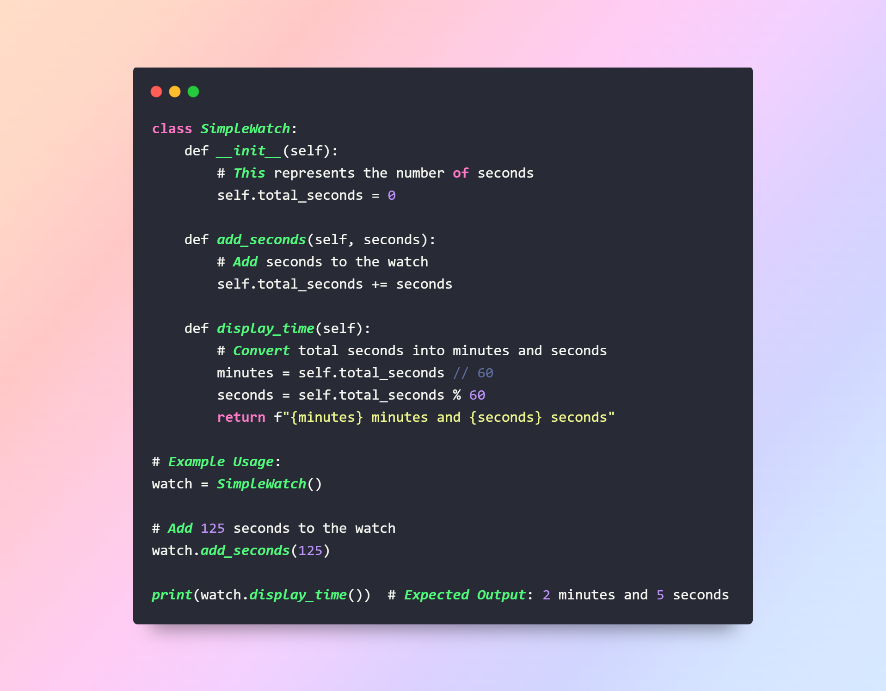
Example:
We have a SimpleWatch class with an attribute total_seconds that starts at 0.
The add_seconds method allows us to add a certain number of seconds to our watch.
The display_time method is our abstraction function. It takes the total_seconds and converts it into minutes and seconds for easy understanding.
We create a SimpleWatch object named watch.
Initially, watch.total_seconds is 0.
We add 125 seconds using watch.add_seconds(125). Now, watch.total_seconds becomes 125.
When we call watch.display_time(), it calculates:
minutes = 125 // 60 which is 2
seconds = 125 % 60 which is 5
So, it returns "2 minutes and 5 seconds", which is what gets printed.
Notes:
class SimpleWatch:
def __init__(self):
# This represents the number of seconds
self.total_seconds = 0
def add_seconds(self, seconds):
# Add seconds to the watch
self.total_seconds += seconds
def display_time(self):
# Convert total seconds into minutes and seconds
minutes = self.total_seconds // 60
seconds = self.total_seconds % 60
return f"{minutes} minutes and {seconds} seconds"
# Example Usage:
watch = SimpleWatch() # Initial total_seconds is 0
watch.add_seconds(125) # Add 125 seconds
print(watch.display_time()) # Expected Output: "2 minutes and 5 seconds"

Slide 7
How they act as abstraction function:
1. Add Seconds:
When you want to make the time go forward, you don't need to worry about all the tiny details inside the watch—like how it works or what's happening inside. You just say, "Hey watch, add 125 seconds," and the watch takes care of it. So, adding seconds is like a magical button you press.
2. Display Time:
Now, when you want to know what the time looks like after adding those seconds, you don't need to open up the watch and look at all the gears and numbers inside. You just ask the watch, "Hey, what's the time now?" And the watch tells you, "It's 2 minutes and 5 seconds." You don't have to understand how the watch calculates that; you just get the answer in a way that makes sense to you.

Slide 8
How abstraction function is differ from simple function
Simple Function:
A simple function does one specific thing. For example, if you had a function called multiply that multiplies two numbers, it just takes those numbers, multiplies them, and gives you the result.
Abstraction Function:
An abstraction function is a bit more magical. It's not just about doing one thing; it's about encapsulating a bunch of steps or actions to make your life easier.
In the case of the SimpleWatch code:
add_seconds is like a magical function that adds seconds to the watch without you needing to know how the watch keeps track of time internally.
display_time is another magical function that takes care of converting total seconds into a human-readable format without you having to understand all the details of that conversion.
Difference:
The key difference is that abstraction functions often hide complex processes or steps behind a simple interface. They take care of a bunch of things for you, making your interaction with the code much easier. Simple functions, on the other hand, tend to do one thing and do it well without necessarily hiding a lot of complexity.

Slide 9


Benefits:
Simplicity: It hides the complex details of the underlying implementation, presenting only the essential features to the user.
Modularity: By separating the abstract view from the concrete implementation, changes can be made to the implementation without affecting the user's view.
Flexibility: Different implementations can be used for the same abstraction, allowing for optimization and customization.
Notes:
**Simplicity:**
In software engineering, simplicity might be like using a library or framework. Consider a web developer building a login system. Instead of writing complex code to handle user authentication from scratch, they can use a library that simplifies the process. The library abstracts away the intricate details of encryption, session management, and database interactions. The developer can focus on integrating the library, making the code cleaner and easier to understand without delving into the complexities of cryptographic algorithms.
**Modularity:**
Think of a content management system (CMS) like WordPress. It's a modular system where different plugins handle various functionalities. If you want to add a feature, like a contact form, you can install a form plugin without rewriting the entire CMS. This modularity allows developers to enhance or modify specific aspects of a system without disrupting the overall structure. Each plugin or module operates independently, much like LEGO bricks snapping together to form a cohesive structure.
**Flexibility:**
Consider a cloud storage service that allows users to choose between different encryption methods for their files. Users can opt for a stronger encryption algorithm if they prioritize security or a faster one for quick access. The flexibility lies in providing users with options. The software allows them to customize the implementation based on their specific needs. It's akin to a car manufacturer offering various engine options, allowing users to select the one that aligns with their preferences—more power or better fuel efficiency.

Slide 10

Challenges:
Performance Overhead: The process of translating between the concrete and abstract views can introduce additional computational costs.
Complexity: Designing a good abstraction function can be challenging, especially for intricate systems.

Slide 11

Rep invariants

Slide 12

Definition:
Rep invariants are conditions or properties that must always hold true for the internal representation of an object. They define the set of valid states for the object and ensure that the object's behavior is consistent and predictable.
In the realm of software development, representation invariants act as the guardians ensuring the integrity and consistency of an object's internal state. Simply put, these are conditions that must always hold true for an object to be considered in a valid state.
Rep Invariants: These are like the rules that a system always follows. For example, in a bank, one rule might be that account balances can't go negative. It ensures everything runs smoothly and predictably.

Slide 13
Real-World Application:
Consider a banking system where account balances should never go negative. The condition "balance >= 0" is a rep invariant for the bank account object. The system should be designed in such a way that this condition is always true, regardless of deposits, withdrawals, or any other operations.

Slide 14
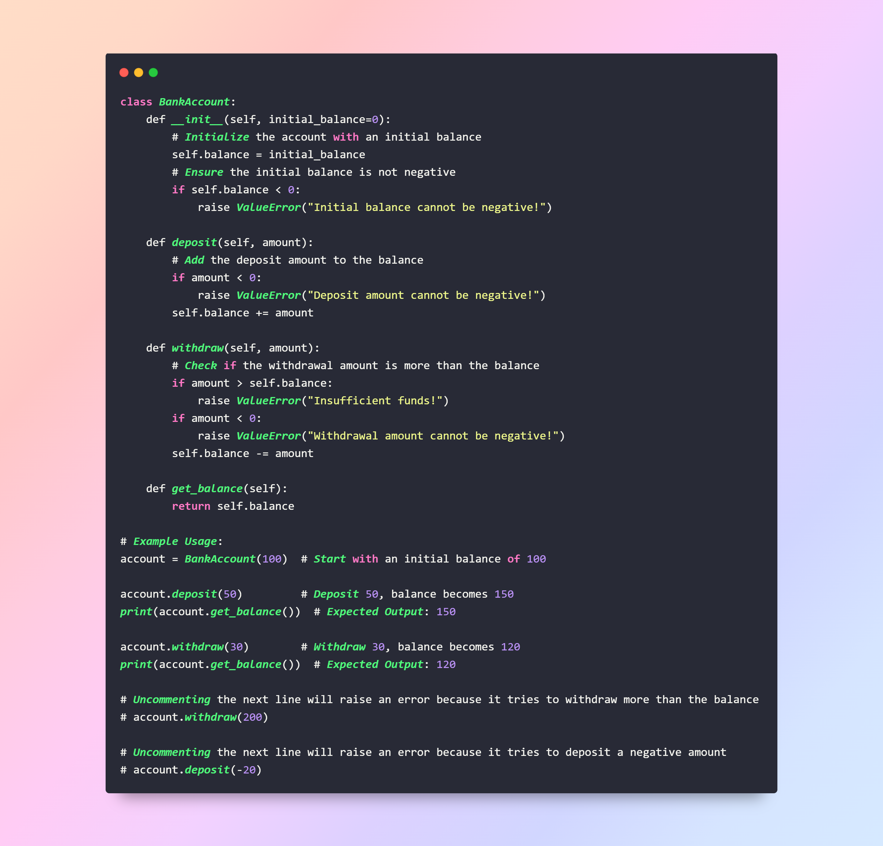
Rep invariants
We have a BankAccount class with a balance attribute.
The deposit method adds money to the account. It checks if the deposit amount is negative and raises an error if it is.
The withdraw method subtracts money from the account. Before doing so, it checks:
If the withdrawal amount is more than the balance (to prevent negative balance).
If the withdrawal amount itself is negative.
The get_balance method simply returns the current balance.
The rep invariant here is the condition that balance >= 0. The design of the BankAccount class ensures this condition is always true by performing checks before deposits and withdrawals.

Slide 15
Benefits:
Consistency: Ensures that objects are always in a valid state, preventing unexpected behaviors.
Safety: By defining and enforcing valid states, rep invariants help in avoiding potential errors or vulnerabilities.
Clarity: They provide clear documentation about the assumptions and conditions under which the system operates.

Slide 16

Challenges:
Maintenance: As systems evolve, rep invariants may need to be updated, which can be challenging if they are deeply embedded in the system.
Complexity: For large systems with multiple interacting components, defining comprehensive rep invariants can be complex.

Slide 17
Code examples of abstraction function:

Slide 18
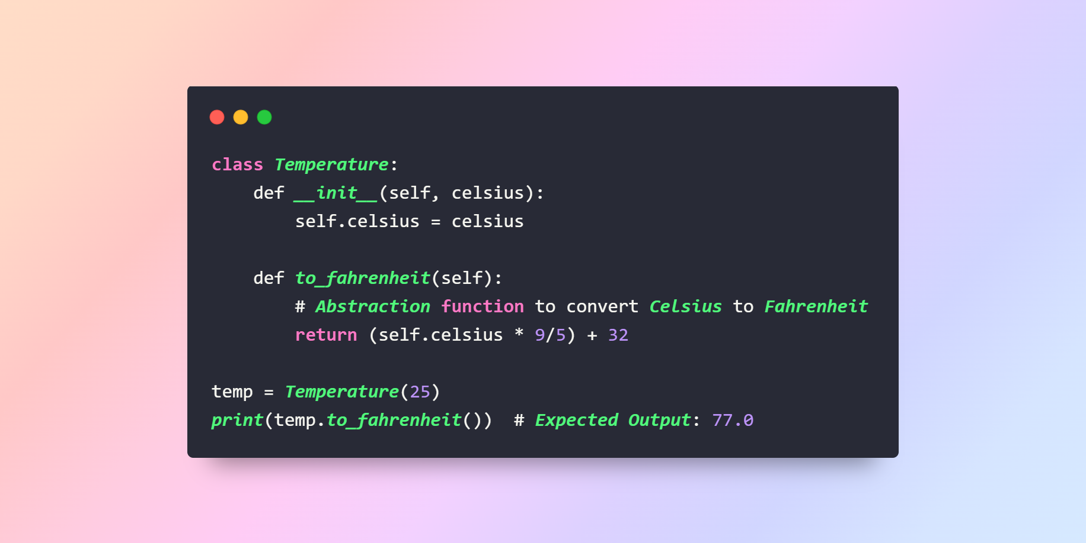
Temperature converter
Notes:
class Temperature:
def __init__(self, celsius):
self.celsius = celsius
def to_fahrenheit(self):
# Abstraction function to convert Celsius to Fahrenheit
return (self.celsius * 9/5) + 32
temp = Temperature(25)
print(temp.to_fahrenheit()) # Expected Output: 77.0

Slide 19
Explanation:
Initialization:
Create a Temperature object with a Celsius value of 25.
The Celsius value is set to 25.
Fahrenheit Conversion:
Convert the Celsius temperature to Fahrenheit using the formula: (Celsius * 9/5) + 32
Fahrenheit = (25 * 9/5) + 32 = 77
Output:
The to_fahrenheit method returns the computed Fahrenheit value.
The Fahrenheit value is 77.0.

Slide 20
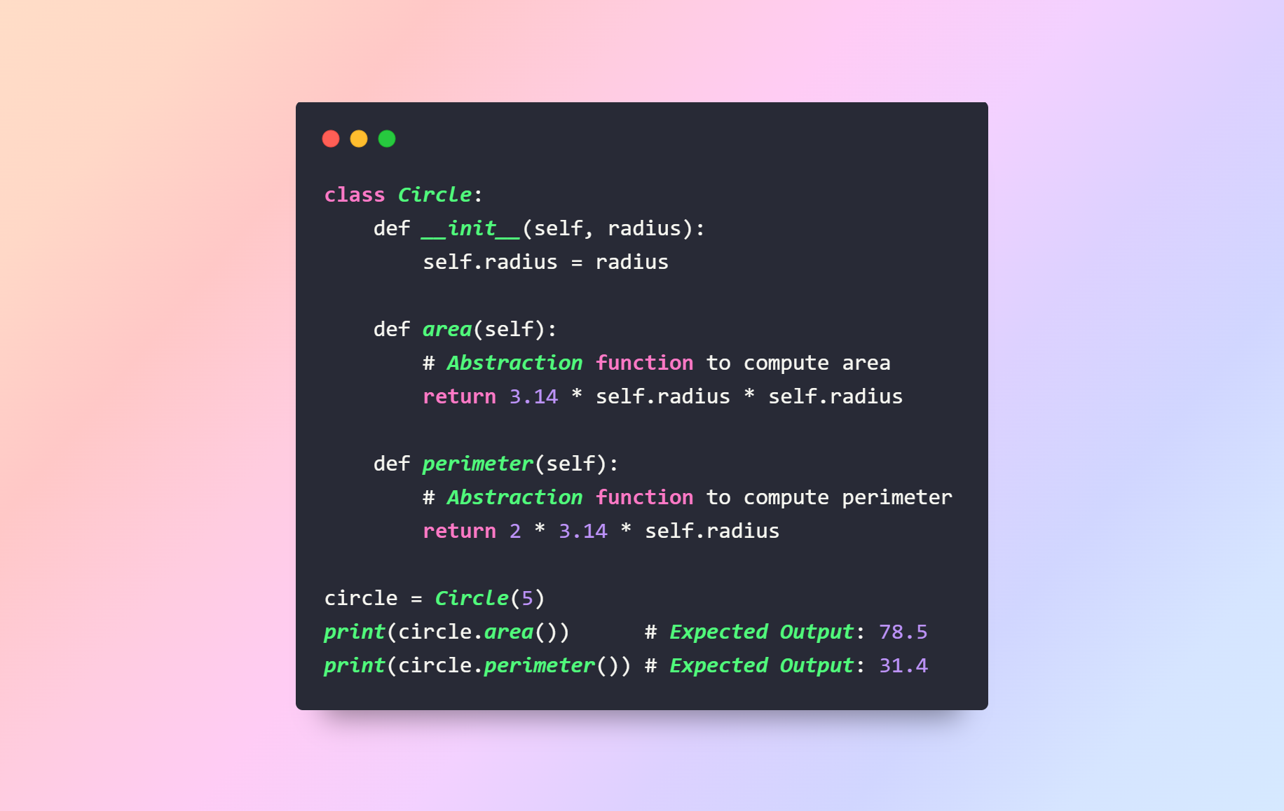
Circle area and perimeter
Notes:
class Circle:
def __init__(self, radius):
self.radius = radius
def area(self):
# Abstraction function to compute area
return 3.14 * self.radius * self.radius
def perimeter(self):
# Abstraction function to compute perimeter
return 2 * 3.14 * self.radius
circle = Circle(5)
print(circle.area()) # Expected Output: 78.5
print(circle.perimeter()) # Expected Output: 31.4

Slide 21
Explanation:
Initialization:
Create a Circle object with a radius of 5.
The radius is set to 5.
Area Calculation:
Calculate the area of the circle using the formula: π * radius^2
Area = 3.14 * 5 * 5 = 78.5
Perimeter Calculation:
Calculate the perimeter of the circle using the formula: 2 * π * radius
Perimeter = 2 * 3.14 * 5 = 31.4
Output:
The area method returns the computed area.
The area is 78.5.
The perimeter method returns the computed perimeter.
The perimeter is 31.4.

Slide 22
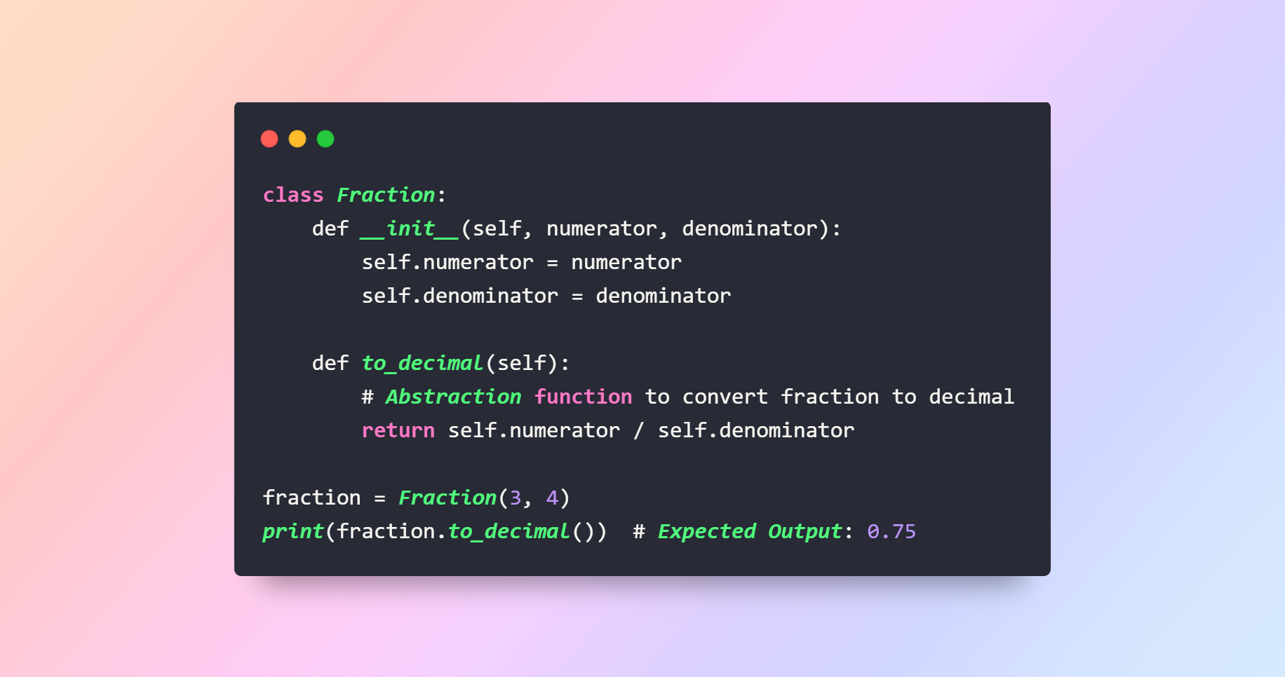
. Simple Fraction:
Notes:
class Fraction:
def __init__(self, numerator, denominator):
self.numerator = numerator
self.denominator = denominator
def to_decimal(self):
# Abstraction function to convert fraction to decimal
return self.numerator / self.denominator
fraction = Fraction(3, 4)
print(fraction.to_decimal()) # Expected Output: 0.75

Slide 23
Explanation:
Initialization:
Create a Fraction object with a numerator of 3 and a denominator of 4.
The numerator is set to 3.
The denominator is set to 4.
Decimal Conversion:
Convert the fraction to a decimal using the formula: numerator / denominator
Decimal value = 3 / 4 = 0.75
Output:
The to_decimal method returns the computed decimal value.
The decimal value is 0.75.

Slide 24

Code examples of rep invariants:

Slide 25
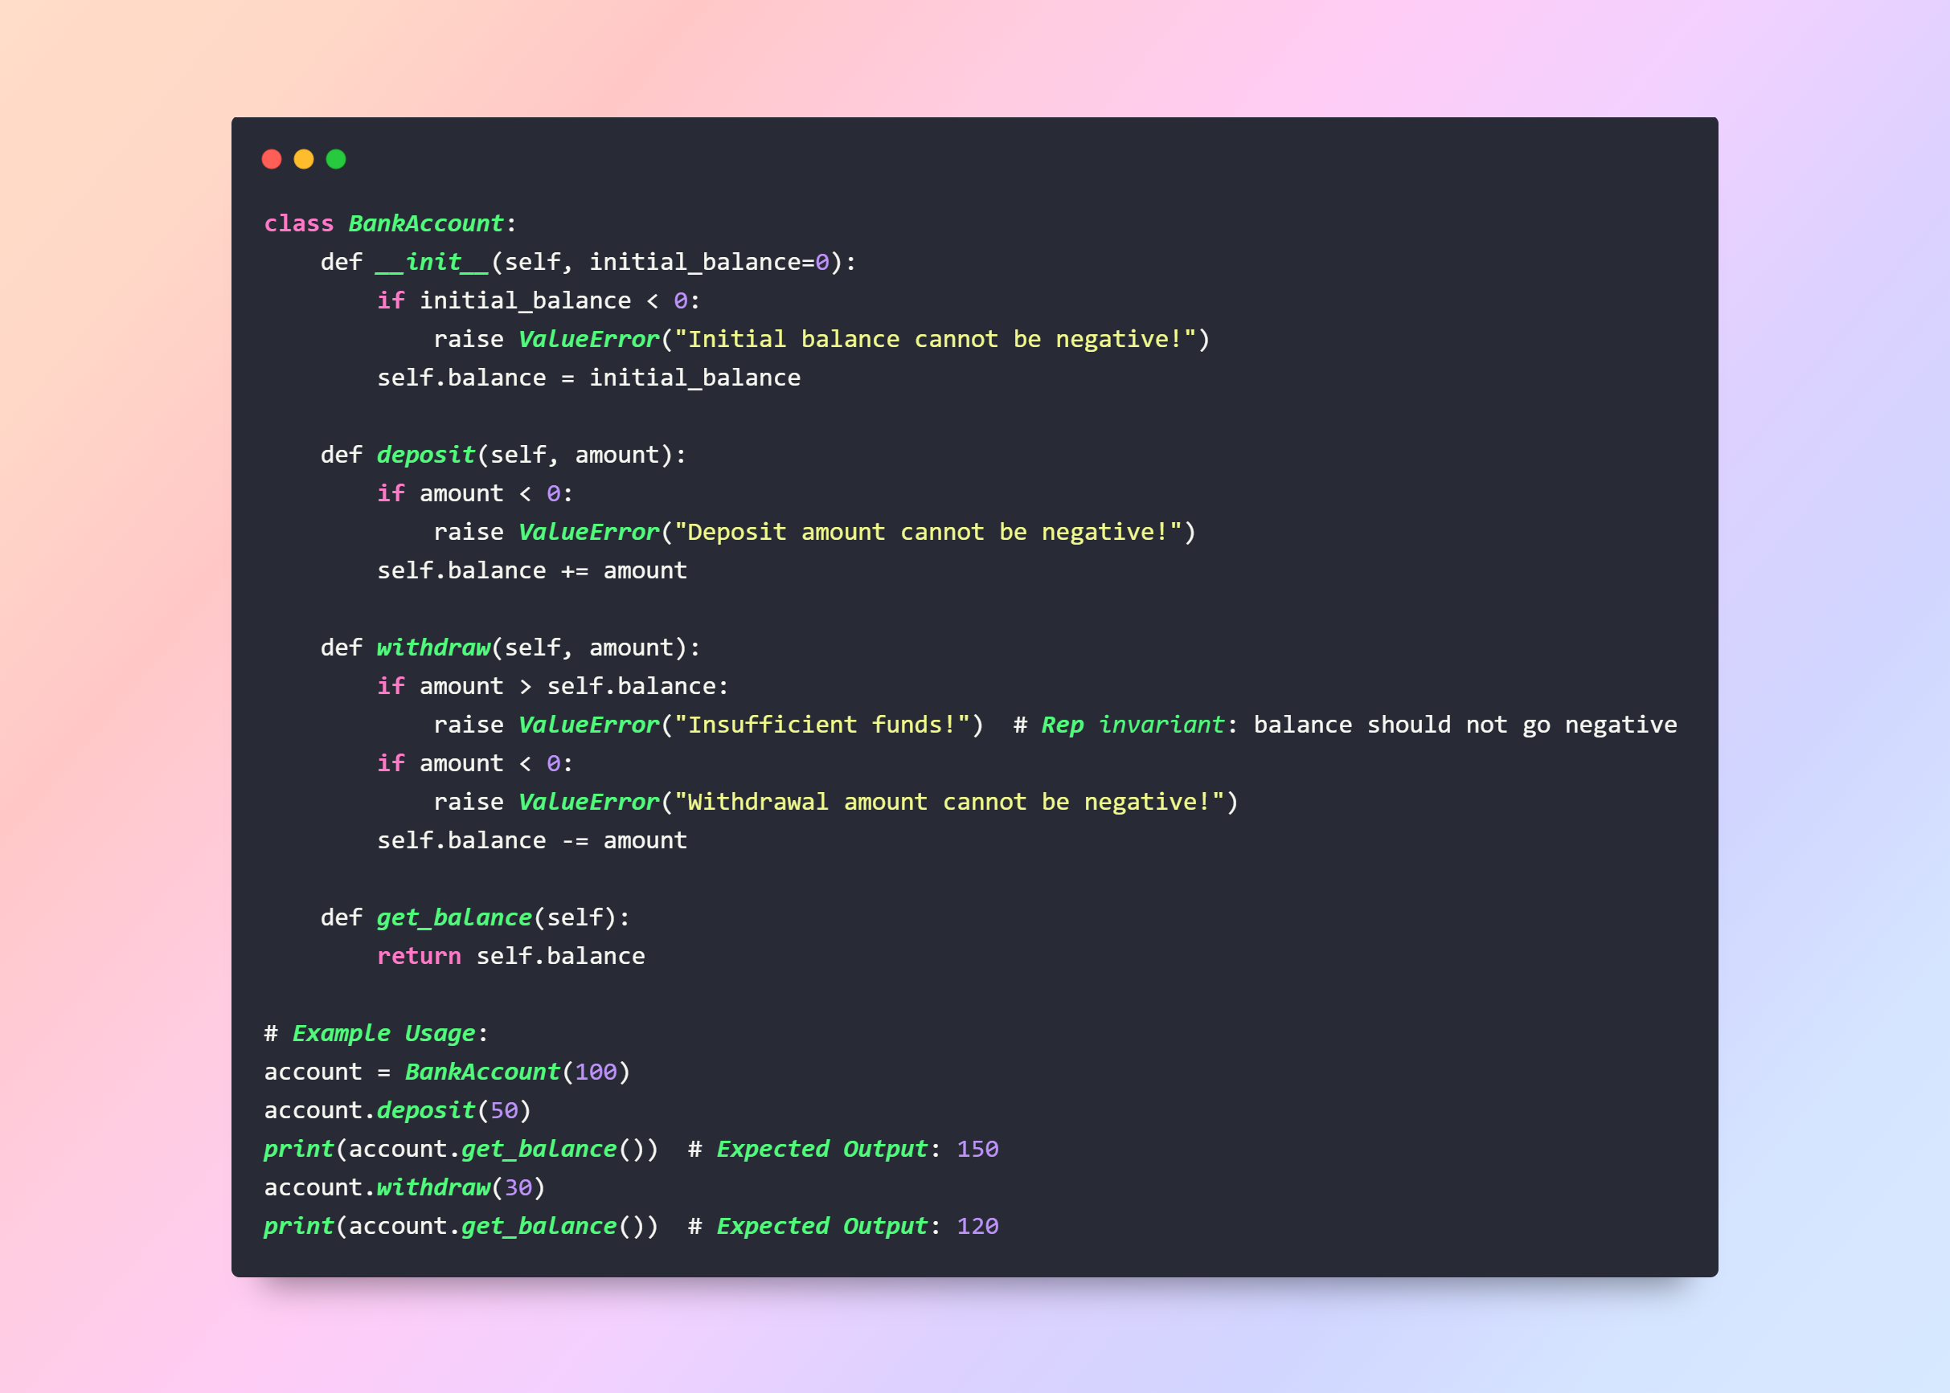
1. Non-negative Bank Account Balance:
Notes:
class BankAccount:
def __init__(self, initial_balance=0):
if initial_balance < 0:
raise ValueError("Initial balance cannot be negative!")
self.balance = initial_balance
def deposit(self, amount):
if amount < 0:
raise ValueError("Deposit amount cannot be negative!")
self.balance += amount
def withdraw(self, amount):
if amount > self.balance:
raise ValueError("Insufficient funds!") # Rep invariant: balance should not go negative
if amount < 0:
raise ValueError("Withdrawal amount cannot be negative!")
self.balance -= amount
def get_balance(self):
return self.balance
# Example Usage:
account = BankAccount(100)
account.deposit(50)
print(account.get_balance()) # Expected Output: 150
account.withdraw(30)
print(account.get_balance()) # Expected Output: 120

Slide 26
Explanation:
Create a BankAccount with an initial balance of 100.
The balance is set to 100.
Deposit:
Deposit 50 into the account.
The balance is increased by 50.
New balance = 100 + 50 = 150.
Withdraw:
Withdraw 30 from the account.
The balance is decreased by 30.
New balance = 150 - 30 = 120.
Output:
The get_balance method returns the current balance.
The balance is 120.

Slide 27
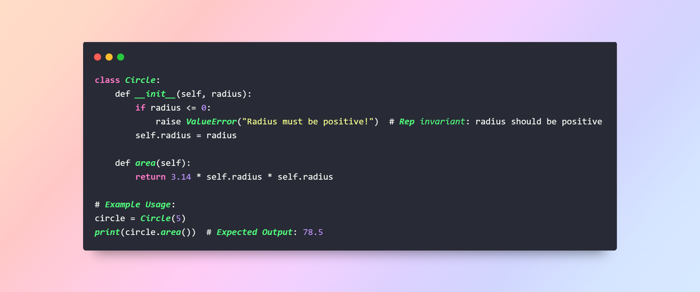
2. Positive Circle Radius:
Notes:
class Circle:
def __init__(self, radius):
if radius <= 0:
raise ValueError("Radius must be positive!") # Rep invariant: radius should be positive
self.radius = radius
def area(self):
return 3.14 * self.radius * self.radius
# Example Usage:
circle = Circle(5)
print(circle.area()) # Expected Output: 78.5

Slide 28
Explanation:
Initialization:
Create a Circle with a radius of 5.
The radius is set to 5.
Area Calculation:
Calculate the area of the circle using the formula: π * radius^2
Area = 3.14 * 5 * 5 = 78.5
Output:
The area method returns the computed area.
The area is 78.5.

Slide 29
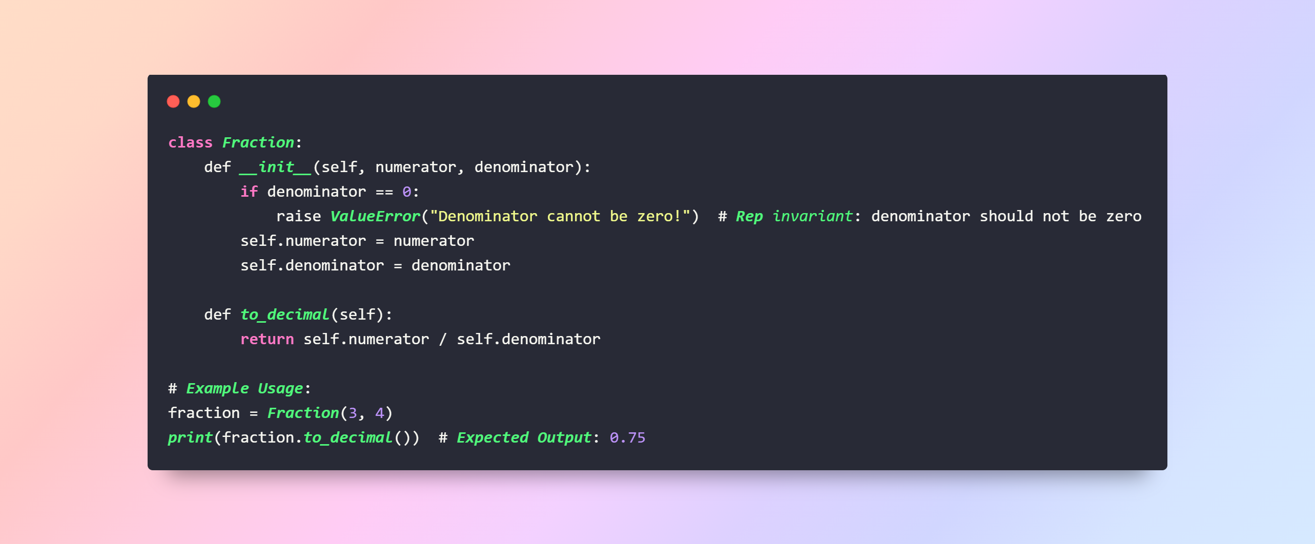
3. Non-zero Denominator in Fraction:
Notes:
class Fraction:
def __init__(self, numerator, denominator):
if denominator == 0:
raise ValueError("Denominator cannot be zero!") # Rep invariant: denominator should not be zero
self.numerator = numerator
self.denominator = denominator
def to_decimal(self):
return self.numerator / self.denominator
# Example Usage:
fraction = Fraction(3, 4)
print(fraction.to_decimal()) # Expected Output: 0.75

Slide 30
Explanation:
Initialization:
Create a Fraction with a numerator of 3 and a denominator of 4.
The numerator is set to 3.
The denominator is set to 4.
Decimal Conversion:
Convert the fraction to a decimal using the formula: numerator / denominator
Decimal value = 3 / 4 = 0.75
Output:
The to_decimal method returns the computed decimal value.
The decimal value is 0.75.

Slide 31


TOOLS USED:

Slide 32

Task 1: MUSIC PLAYER SYSTEM
Design a class Song that internally stores all the metadata of a song.
Implement an abstraction function in the Song class that returns a dictionary with only the song title, artist, and duration.
Demonstrate the functionality by creating a few Song objects and displaying their simplified views.

Slide 33


Task 2: VEHICLE MANAGEMENT SYSTEM
Design a class Vehicle that internally stores all the specifications of a vehicle.
Implement an abstraction function in the Vehicle class that returns a dictionary with only the vehicle's make, model, and year.
Demonstrate the functionality by creating a few Vehicle objects and displaying their quick overviews.

Slide 34

Task 3: E-COMMERCE PRODUCT LISTING
Design a class Product that internally stores all the attributes of a product.
Implement an abstraction function in the Product class that returns a dictionary with only the product name, price, and image.
Demonstrate the functionality by creating a few Product objects and displaying their listings.

Slide 35

Task 4: LIBRARY BOOK MANAGEMENT
Design a class Book that stores the ID, title, author, and number of copies available.
Implement rep invariants to ensure that:
The book ID is unique.
The number of copies available is never negative.
Demonstrate the functionality by creating a few Book objects and trying to set negative copies or duplicate IDs.

Slide 36

Task 5: UNIVERSITY STUDENT REGISTRATION
Design a class Student that stores the student number, name, and a list of enrolled courses.
Implement rep invariants to ensure that:
The student number is unique.
A student is not enrolled in the same course more than once.
Demonstrate the functionality by creating a few Student objects and trying to enroll them in the same course multiple times or assign duplicate student numbers.

Slide 37

THANK YOU

